Slide 1


Computer Architecture Spring 2020
Hamed Farbeh
farbeh@aut.ac.ir
Department of Computer Engineering
Amirkabir University of Technology
Register Transfer Language (RTL)

Slide 2
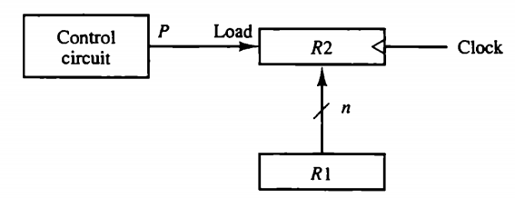
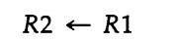
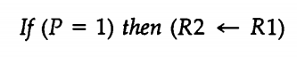
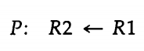
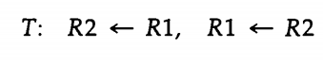
Register Transfer Level
Computer Architecture-Spring 2020, AUT, Tehran, Iran

Slide 3
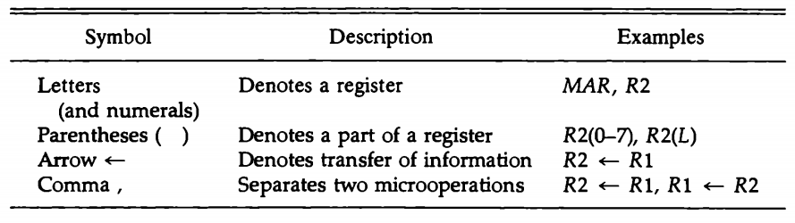
Register Transfer Level
Computer Architecture-Spring 2020, AUT, Tehran, Iran

Slide 4
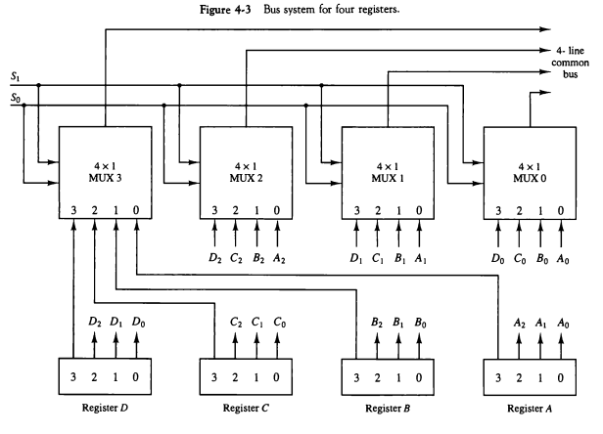
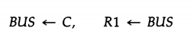
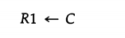
RTL- BUS
Computer Architecture-Spring 2020, AUT, Tehran, Iran

Slide 5
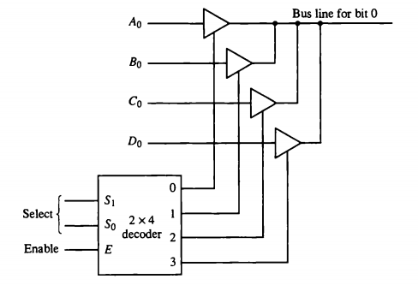
RTL- BUS
Computer Architecture-Spring 2020, AUT, Tehran, Iran

Slide 6
RTL- Memory Transfer
Read: DR ← M[AR]
Write: M[AR] ← R1
Computer Architecture-Spring 2020, AUT, Tehran, Iran

Slide 7
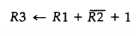
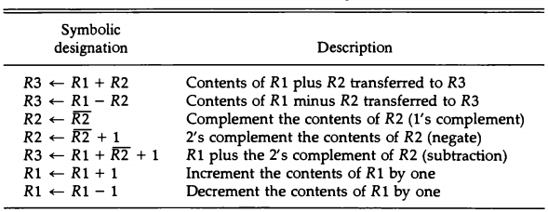
RTL- Arithmetic
Computer Architecture-Spring 2020, AUT, Tehran, Iran

Slide 8
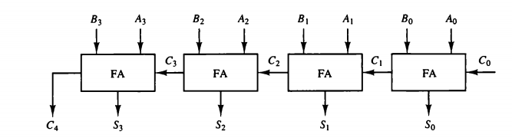
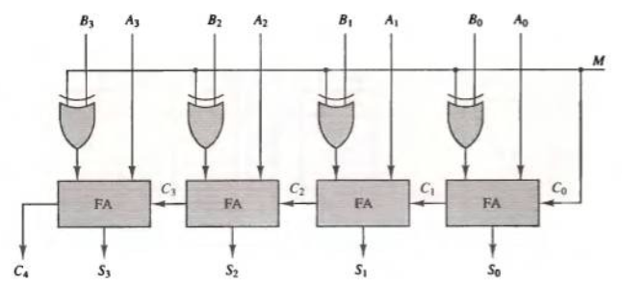
RTL- Binary Adder/Subtractor
Computer Architecture-Spring 2020, AUT, Tehran, Iran

Slide 9
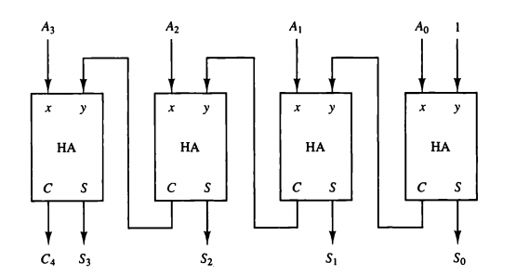
RTL- Binary Incrementer
Computer Architecture-Spring 2020, AUT, Tehran, Iran

Slide 10
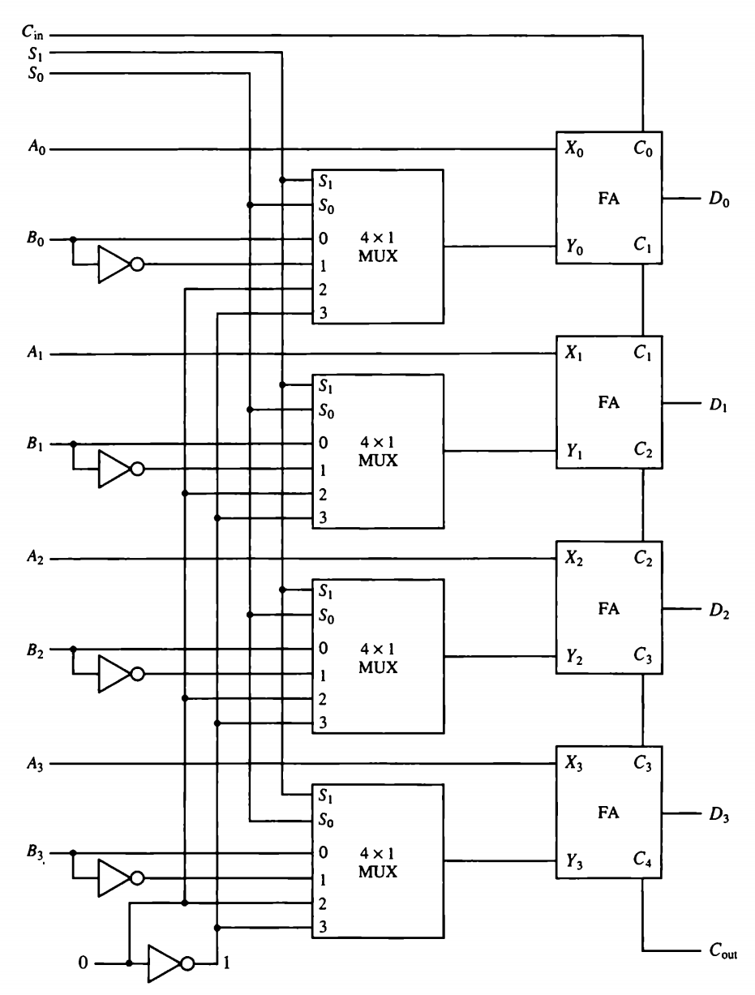
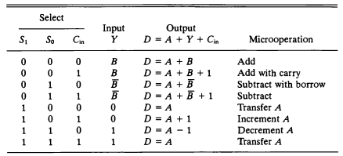
RTL- Binary Arithmetic Circuit
Computer Architecture-Spring 2020, AUT, Tehran, Iran

Slide 11
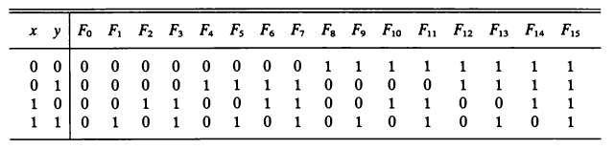
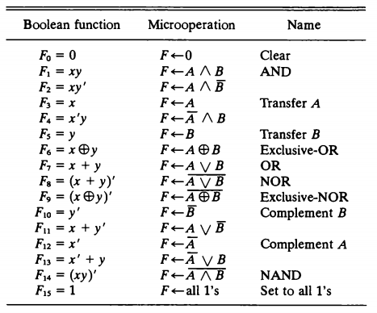
RTL- Binary Logic Functions and μop
Computer Architecture-Spring 2020, AUT, Tehran, Iran

Slide 12
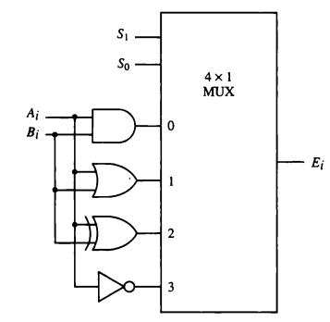
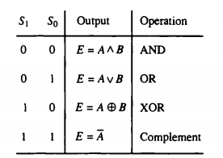
RTL- Binary Logic Circuit
Computer Architecture-Spring 2020, AUT, Tehran, Iran

Slide 13
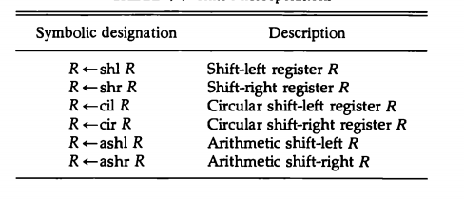
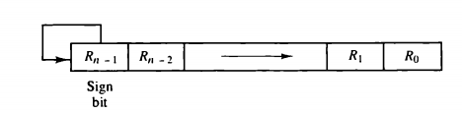
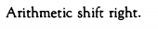
RTL- Shift Microoperations
Computer Architecture-Spring 2020, AUT, Tehran, Iran

Slide 14
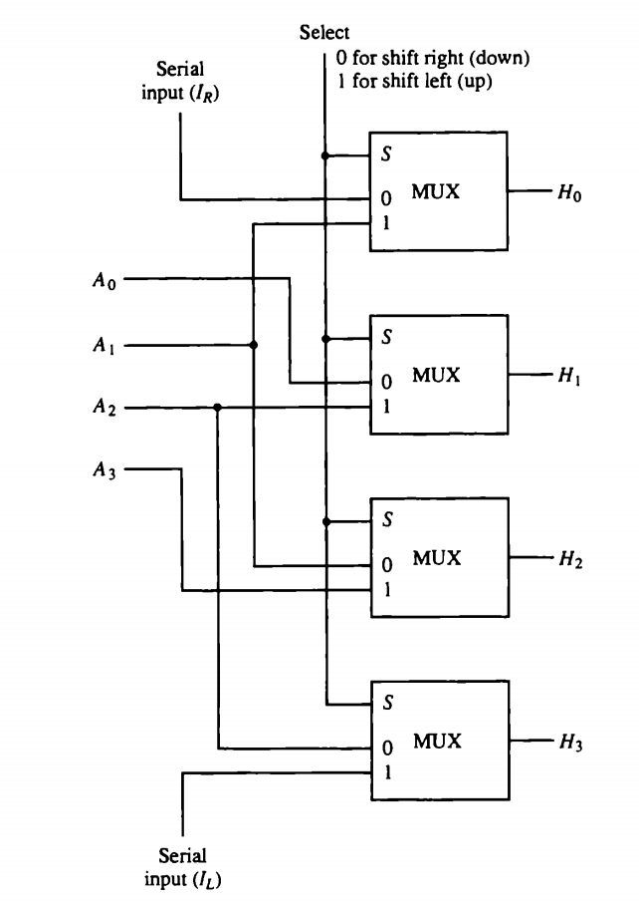
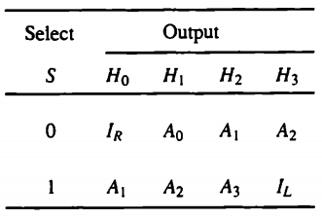
RTL- Shifter Circuit
Computer Architecture-Spring 2020, AUT, Tehran, Iran

Slide 15

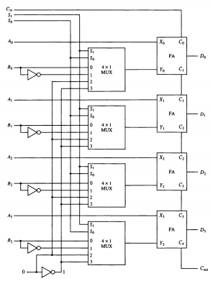
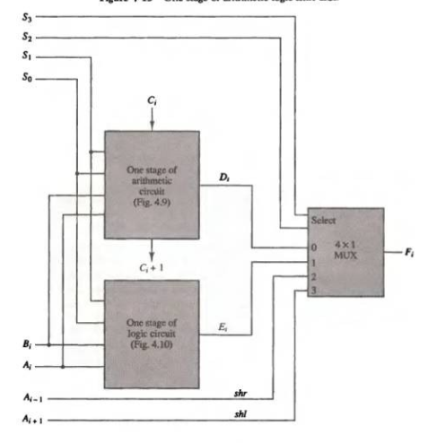
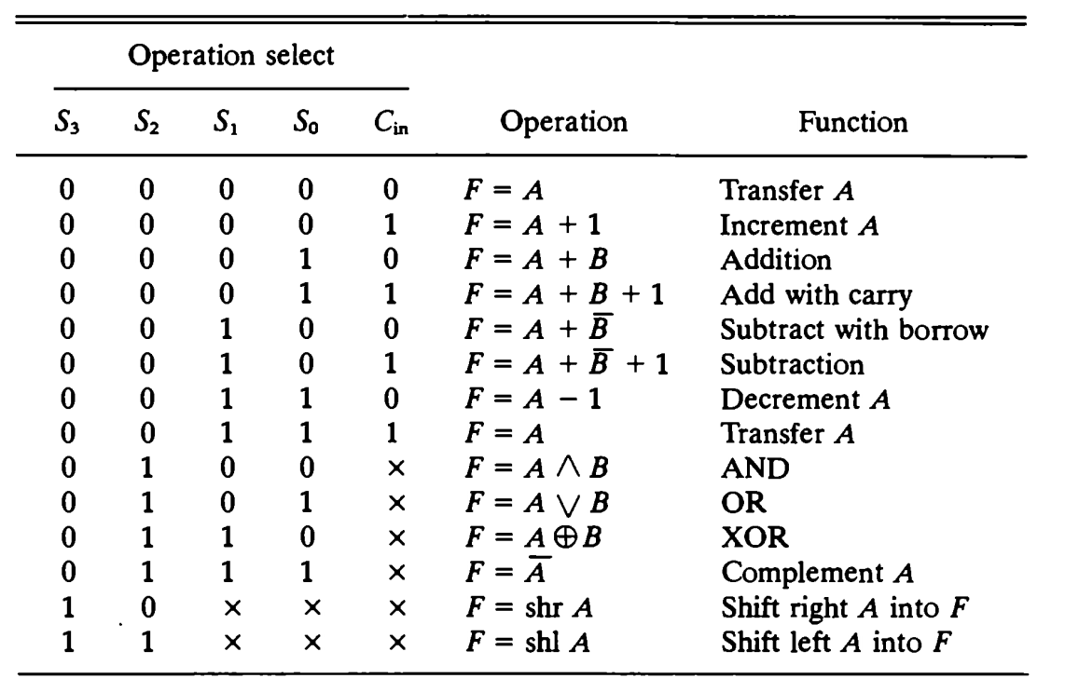

RTL- Arithmetic Logic Shift Unit
Computer Architecture-Spring 2020, AUT, Tehran, Iran

